Slide 2
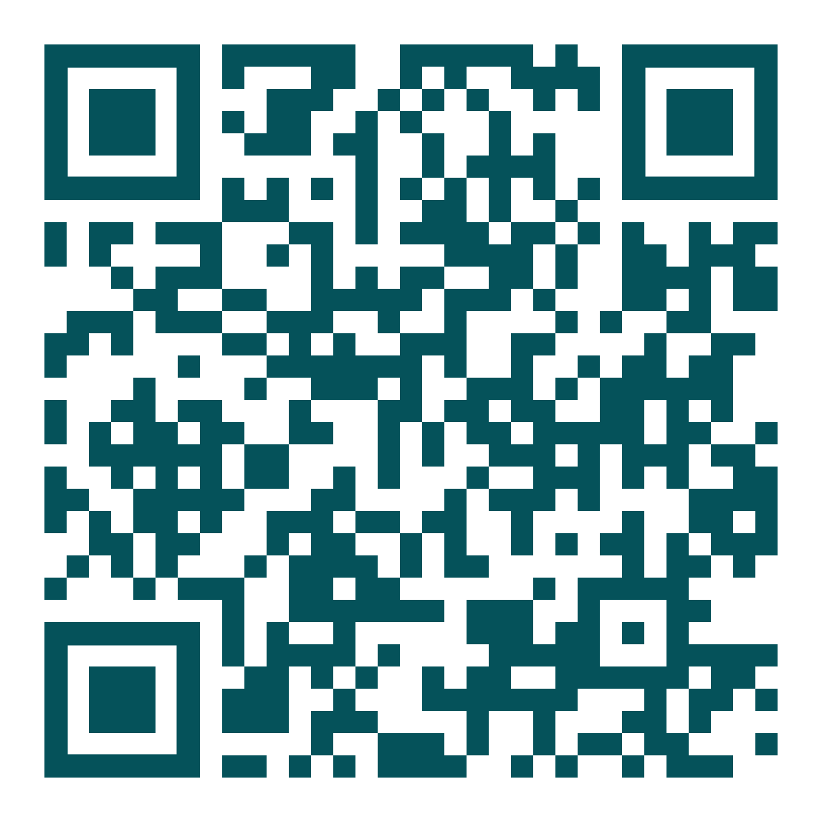
github.com/TaceoLabs/noir_workshop_0625/

Slide 3
Our mission
Building a coSNARK-powered DApp with coNoir
Shuffling Cards with MPC

Slide 4



Slide 5
Let’s play cards

Slide 6
Sure, but I’ll shuffle you cheat

Slide 7

No, I’ll shuffle you scoundrel

Slide 8

Please shuffle the cards for us

Slide 9
I like Alice more

Slide 10
hey Charlette – I’ll pay you 5$

Slide 12
What now?
Private State only gets you that far

Slide 13
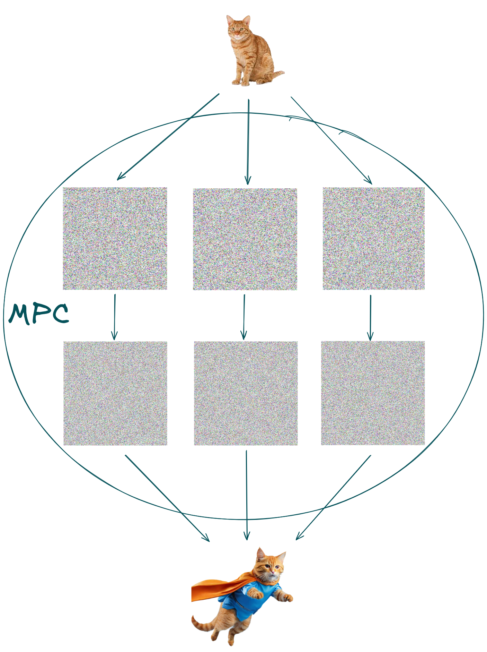

Slide 14

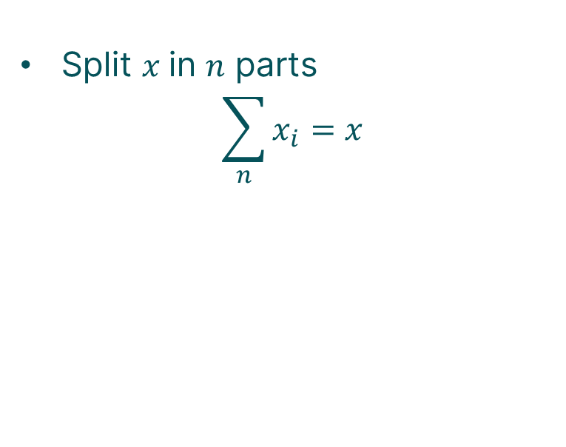
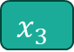
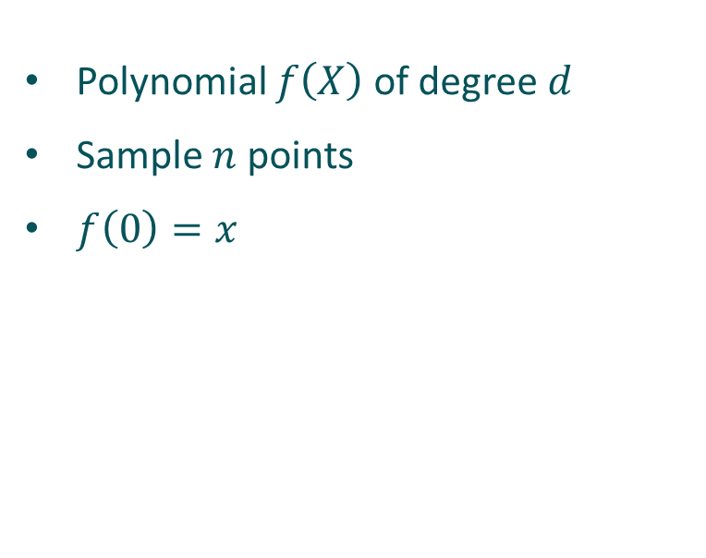

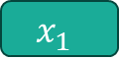

Mpc 101
How to share a secret?
Shamir Secret Sharing
Additive Secret Sharing
Polynomial $f\left(X\right)$ of degree $d$
Sample $n$ points
$f\left(0\right)=x$
Split $x$in $n$ parts
$$\sum_{n}{x_{i}}=x$$
$$x$$
$$x_{1}$$
$$x_{2}$$
$$x_{3}$$

Slide 15

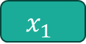
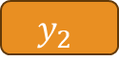
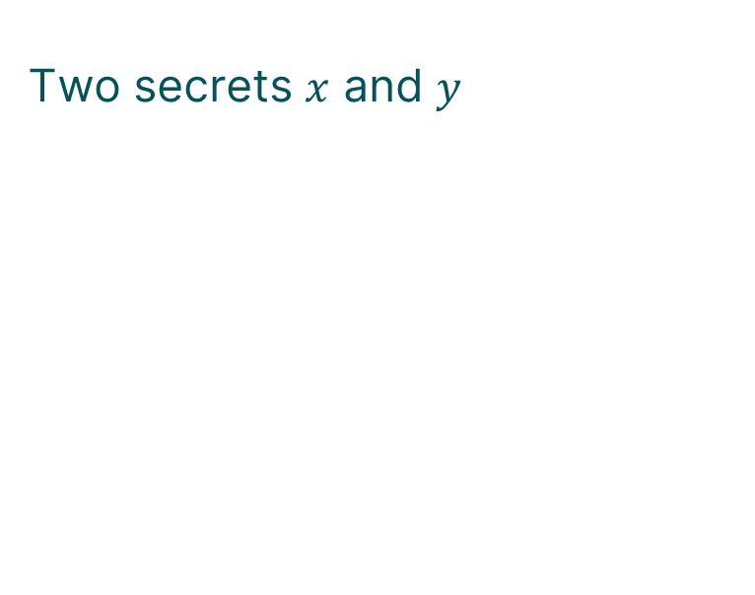

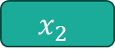

Mpc 101
Computing on secrets
Addition
Two secrets $x$ and $y$
$$x_{1}$$
$$y_{1}$$
$$x_{2}$$
$$y_{2}$$
$$x_{3}$$
$$y_{3}$$

Slide 16
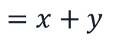



Mpc 101
Computing on secrets
Addition
Two secrets $x$ and $y$
$$x_{1}$$
$$y_{1}$$
$$x_{2}$$
$$y_{2}$$
$$x_{3}$$
$$y_{3}$$
$$x_{1}+y_{1}$$
$$x_{2}+y_{2}$$
$$=x+y$$
$$x_{3}+y_{3}$$

Slide 17

Mpc 101
Computing on secrets
Addition
Multiplication
Two secrets $x$ and $y$
$$x_{1}$$
$$y_{1}$$
$$x_{2}$$
$$y_{2}$$
$$x_{3}$$
$$y_{3}$$
$$x_{1}+y_{1}$$
$$x_{2}+y_{2}$$
$$=x+y$$
$$x_{3}+y_{3}$$

Slide 18
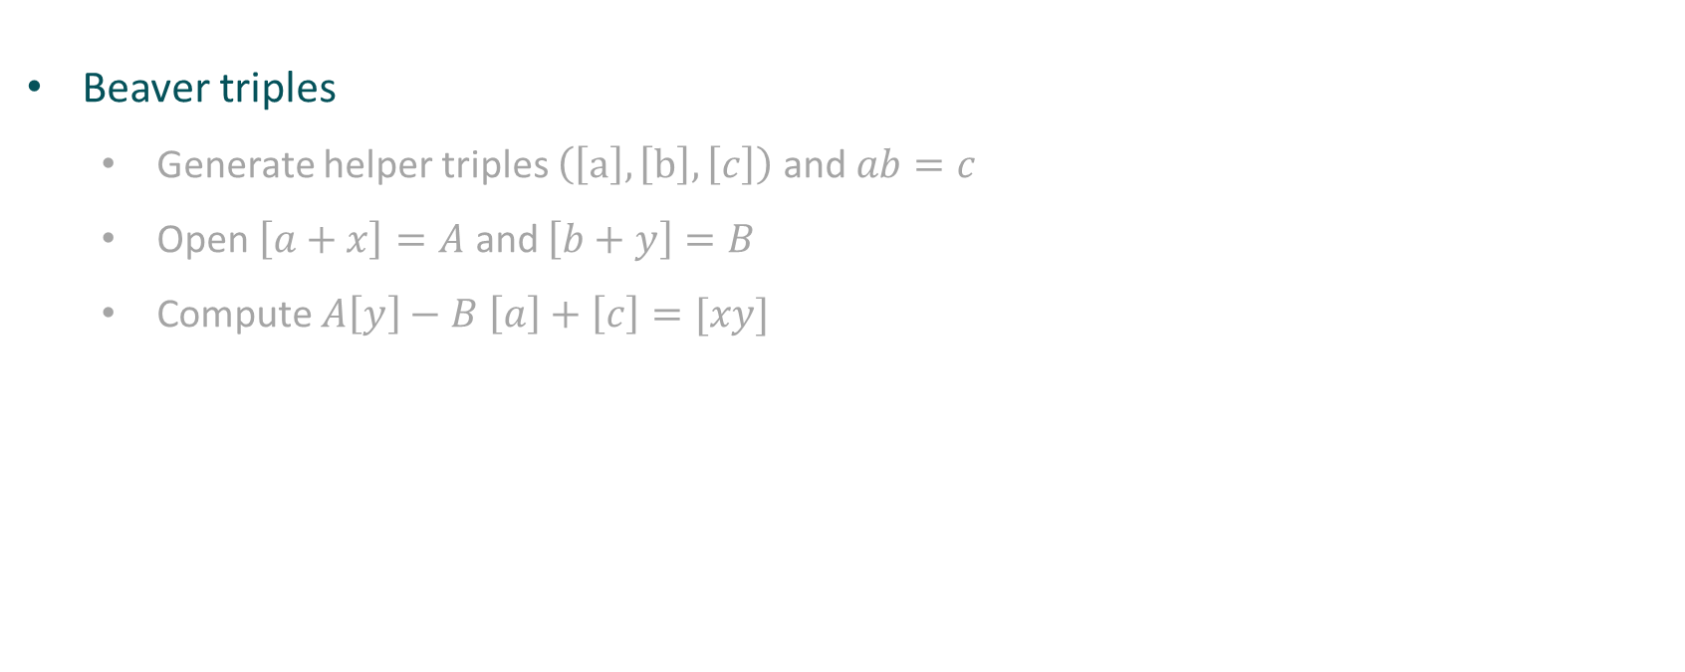
Mpc 101
Non-linear Operations
Beaver triples
Generate helper triples $\left(\left[a\right],\left[b\right],\left[c\right]\right)$ and $ab=c$
Open $\left[a+x\right]=A$ and $\left[b+y\right]=B$
Compute $A\left[y\right]−B \left[a\right]+\left[c\right]=[xy]$

Slide 19
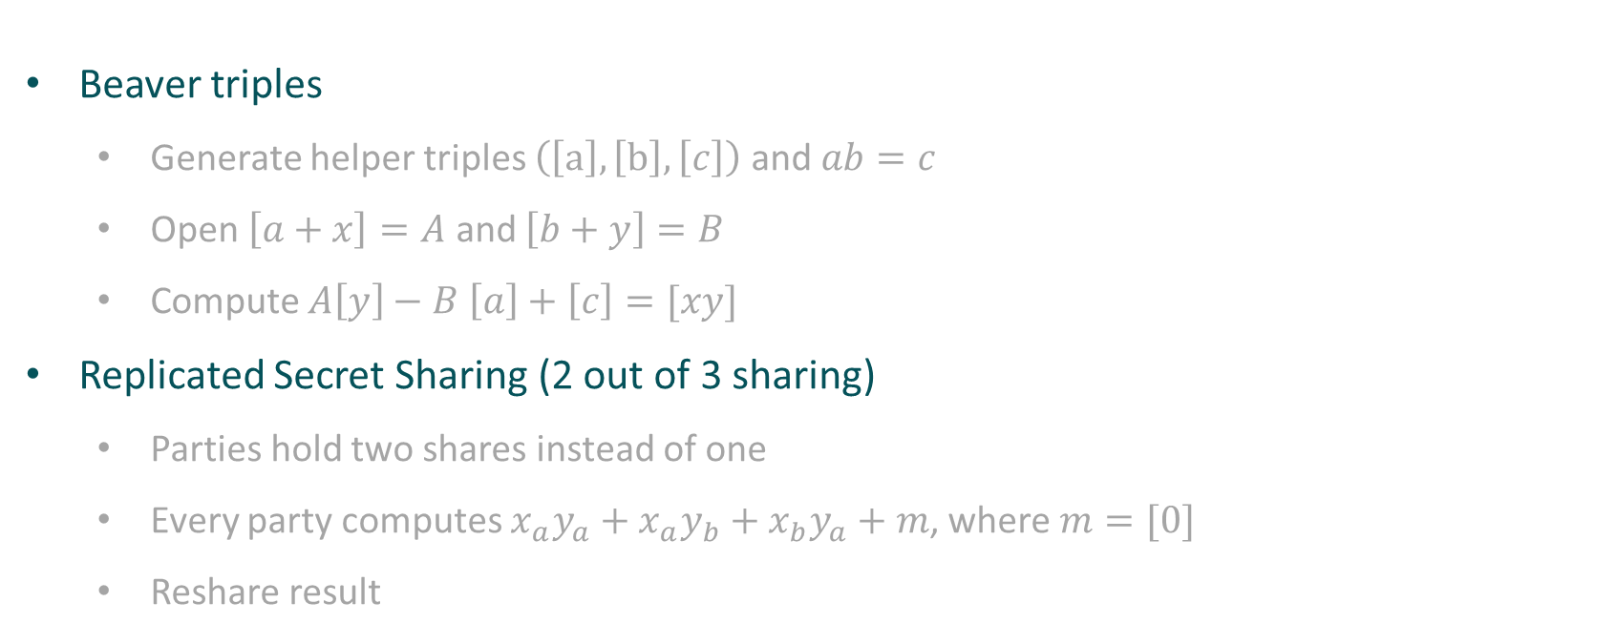
Mpc 101
Non-linear Operations
Beaver triples
Generate helper triples $\left(\left[a\right],\left[b\right],\left[c\right]\right)$ and $ab=c$
Open $\left[a+x\right]=A$ and $\left[b+y\right]=B$
Compute $A\left[y\right]−B \left[a\right]+\left[c\right]=[xy]$
Replicated Secret Sharing (2 out of 3 sharing)
Parties hold two shares instead of one
Every party computes $x_{a}y_{a}+x_{a}y_{b}+x_{b}y_{a}+m$, where $m=[0]$
Reshare result

Slide 20
Great – what now?

Slide 21
How did we get here
zkSNARKs 101
Succinct proof for computational integrity
Keeping secret input hidden (potentially)

Slide 22

How did we get here
zkSNARKs 101
Succinct proof for computational integrity
Keeping secret input hidden (potentially)

Slide 23
How did we get here
MPC 101
Mutually untrusting parties jointly compute a function
Inputs and intermediate values private (secret-shared)

Slide 24

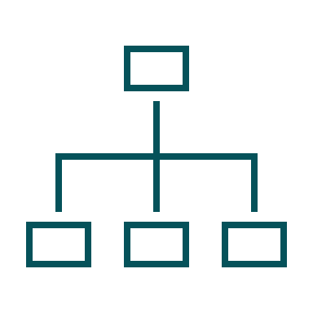
how did we get here
What are coSNARKs?
Zero-Knowledge
MPC

Slide 25

how did we get here
What are coSNARKs?
Zero-Knowledge
MPC
co-SNARKs

Slide 26
How did we get here
Co-SNARK 101
Succinct proof for computational integrity
Keeping secret inputs and intermediate values hidden
Mutually untrusting parties jointly compute a function

Slide 27

[r1]
[r2]

Slide 28


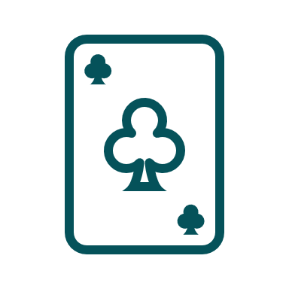
Here is a shuffled deck and a proof

Slide 29
Look we have a shuffled deck
And we don’t know what we’ll draw

Slide 30

Look we have a shuffled deck
And we don’t know what we’ll draw

Slide 31
We are done, right?

Slide 32
Let’s think this through

Slide 33
Let’s think this through
Playing a game of cards
Shuffled the deck

Slide 34
Let’s think this through
Playing a game of cards
Shuffled the deck
Only distribute cards to respective players (verifiable encryption)

Slide 35
Let’s think this through
Playing a game of cards
Shuffled the deck
Only distribute cards to respective players (verifiable encryption)
No one knows the
structure of deck!

Slide 36
Let’s think this through
Playing a game of cards
Private Shared State
Shuffled the deck
Only distribute cards to respective players (verifiable encryption)
Not simply composing Alice and Bobs private state
We generate new private state that nobody knows
But: No input verification so far!
No one knows the
structure of deck!

Slide 37
Look we have a shuffled deck
And we don’t know what we’ll draw

Slide 38
Look we have a shuffled deck
Really?
And we don’t know what we’ll draw

Slide 39
Towards publicly-auditable MPC
[r1]
[r2]

Slide 40
Towards publicly-auditable MPC
I don’t like r1, let’s take r5
[r1]
[r2]
=> Solution: Always bind data to public commitments

Slide 41
Towards publicly-auditable MPC

Slide 42
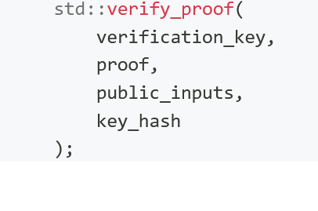
Interop with Aztec
UltraHonk Proof System
Full Client-IVC Proof System
Currently supported by coNoir
Recurse into smart contract
Prove whole Aztec transactions in MPC
Create Aztec keys that are secret-shared and own Private State

Slide 43
github.com/TaceoLabs/noir_workshop_0625/

Slide 44
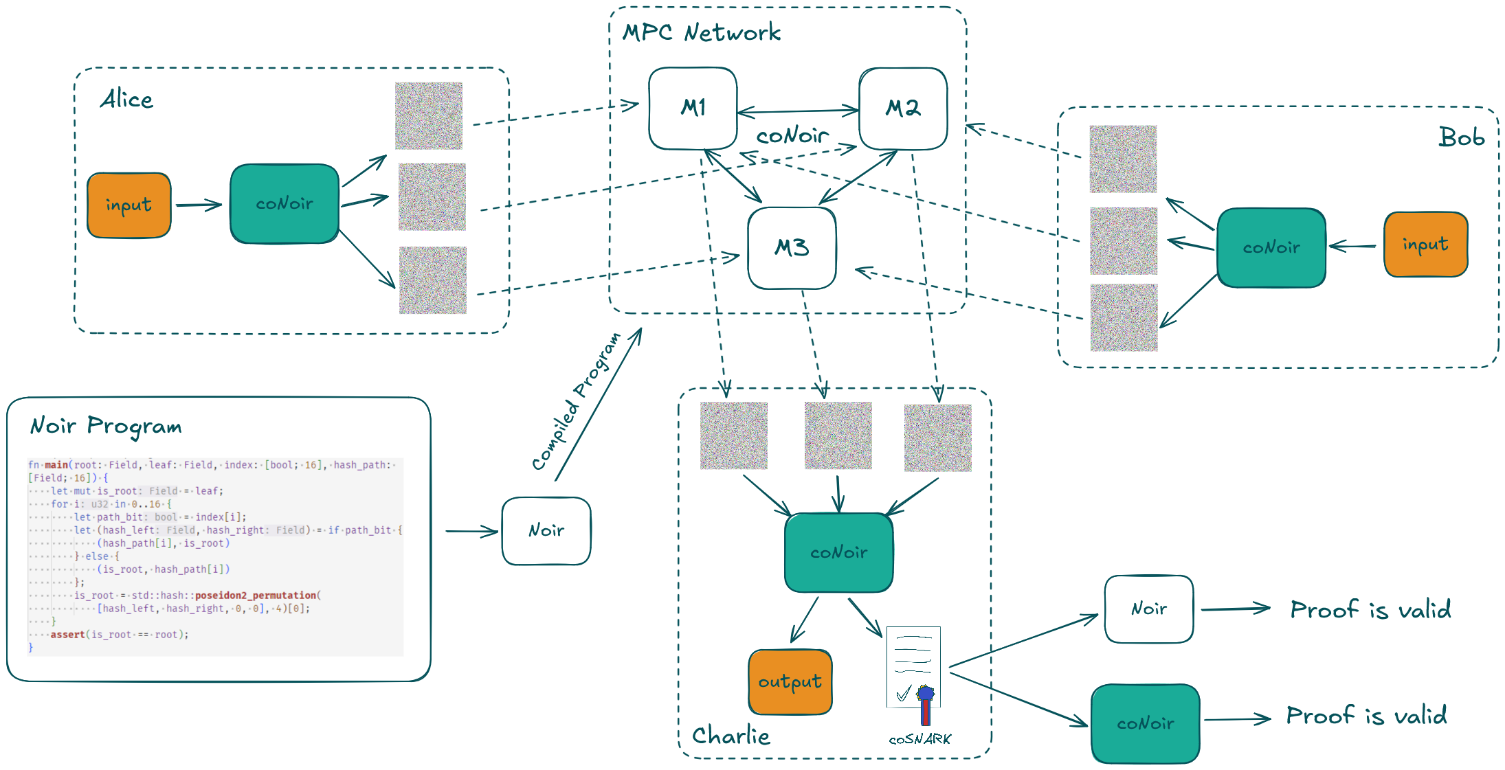

Slide 45
Follow us!

